Slide 1






4D Mesh Reconstruction from Time-Varying Geometry through ARAP Tracking
L. Blache¹, M. Desbrun², C. Loscos¹ and L. Lucas¹
¹University of Reims Champagne-Ardenne, ²Caltech

Slide 2
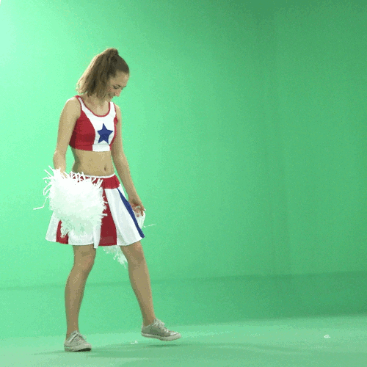
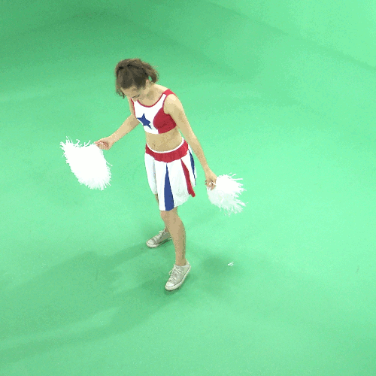
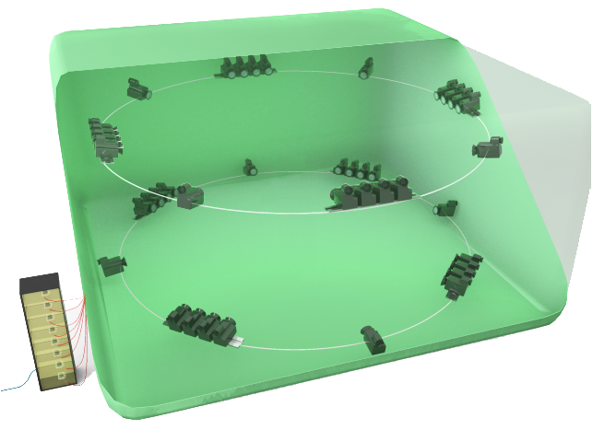
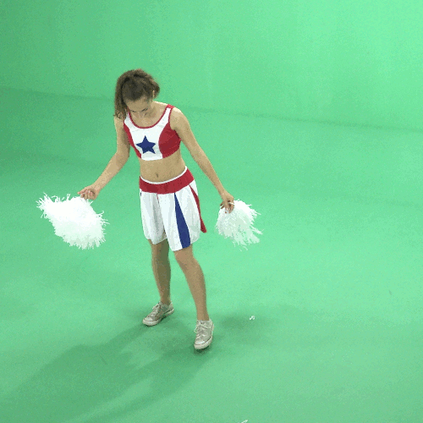
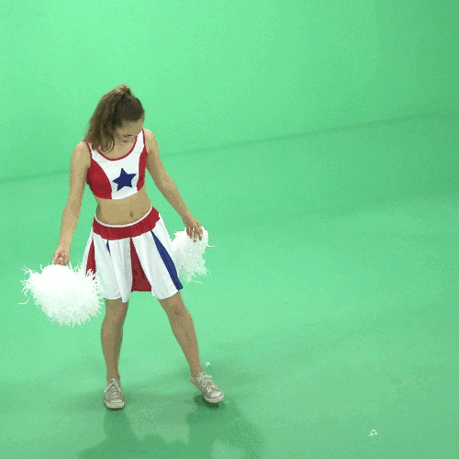
Context: Multiview reconstruction
Multi-viewpoint cameras
Multiview reconstruction studio

Slide 3
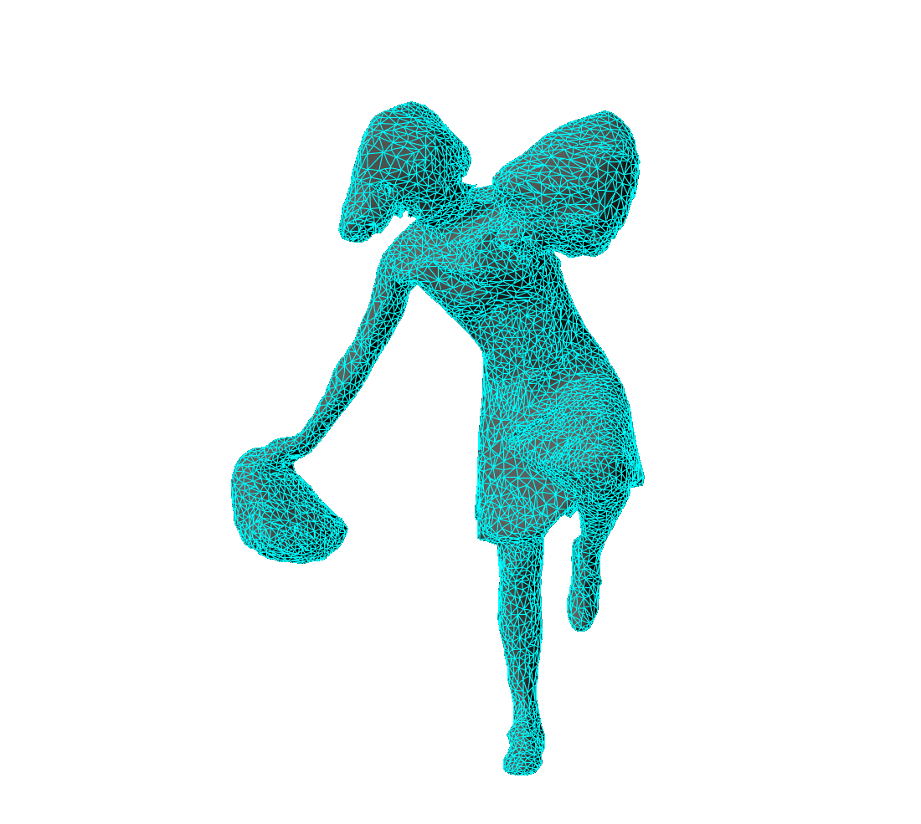
Context: Multiview reconstruction
Model-free reconstruction, based on volumetric intersection of silhouettes (visual hull)
Surfaces' extraction produces mesh sequences
Lack of temporal consistency
Hardly usable in post-production pipeline
Reconstructed mesh sequence

Slide 4
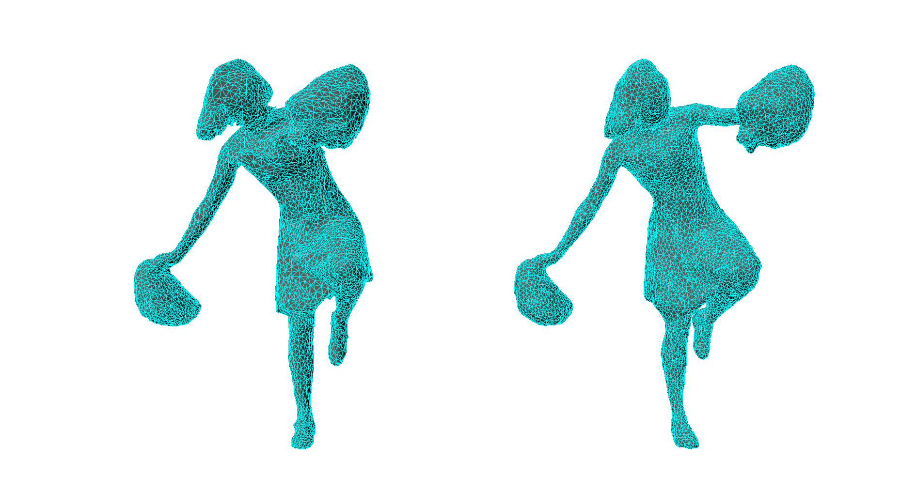
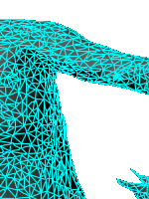
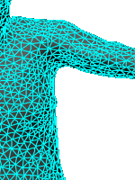
Context: Multiview reconstruction
Model-free reconstruction, based on volumetric intersection of silhouettes (visual hull)
Surfaces' extraction produces mesh sequences
Lack of temporal consistency
Hardly usable in post-production pipeline
Reconstructed mesh sequence
Temporally consistent mesh animation

Slide 5
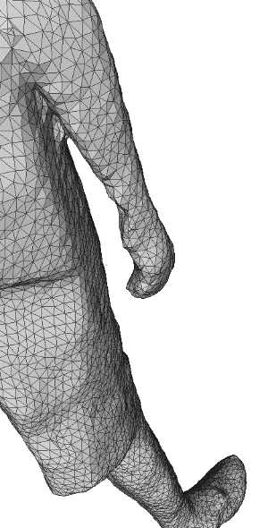
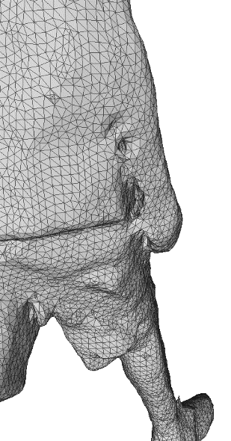
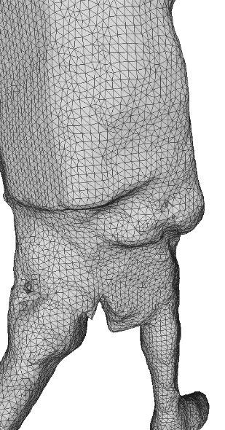
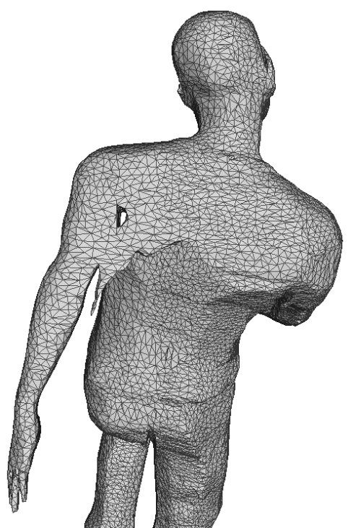
Input data
Input data:
No topological consistency on the successive surfaces
Visual hull: contains artifacts and/or inconsistencies
Proposed solution:
Point-based tracking approach
Directly working on reconstructed discrete volumes (intersection of volumetric silhouettes)

Slide 6
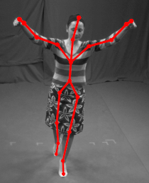
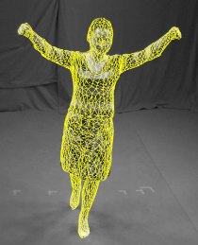
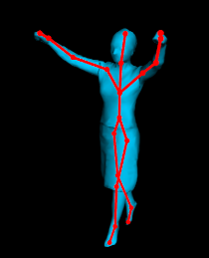
Previous work
Model-based reconstruction
Articulated models
[Vlasic et al. 2008], [Gall et al. 2009], [Duveau 2012] …
Other deformable models
[De Aguiar et al. 2008], [Cagniart et al. 2010], [Letouzey et al. 2012] …

Slide 7
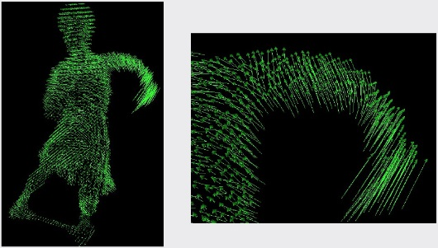
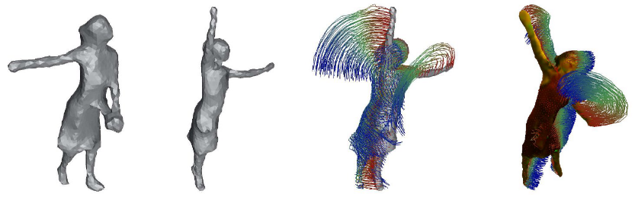
Previous work
Model-based reconstruction
Model-free reconstruction
Articulated models
[Vlasic et al. 2008], [Gall et al. 2009], [Duveau 2012] …
Other deformable models
[De Aguiar et al. 2008], [Cagniart et al. 2010], [Letouzey et al. 2012] …
Motion flow
[Petit et al. 2011], [Nobuhara & Matsuyama 2004], [Anuar & Guskov 2004] …
Feature tracking
[Starck & Hilton 2007], [Varanasi et al. 2008], [Tung & Matsuyama 2010] …

Slide 8
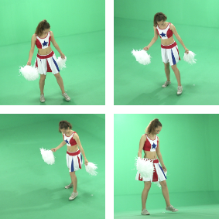
Our approach
Model-free Reconstruction
Template Mesh
Motion Flow
Mesh Animation
Global Deformation
Local Optimization
Volume Sequence
Volumes
EDT

Slide 9
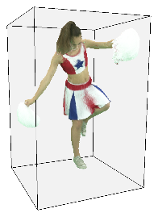
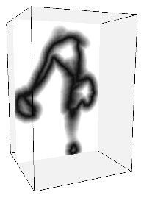
Our approach
Textured Volume: each surface voxel is associated with an RGB color
EDT: each voxel is associated with a grey level value (Euclidean distance)
Model-free Reconstruction
Template Mesh
Motion Flow
Mesh Animation
Global Deformation
Local Optimization
Volume Sequence
Volumes
EDT

Slide 10
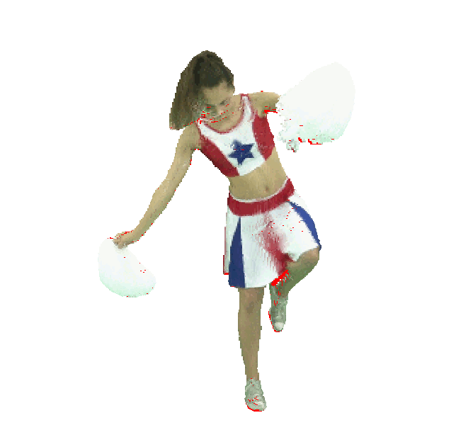

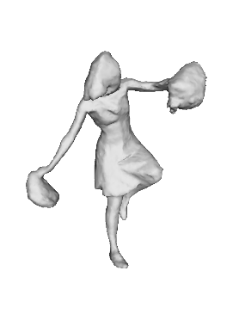
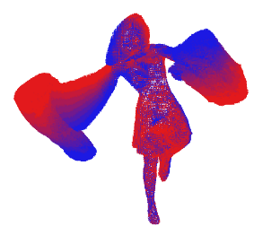
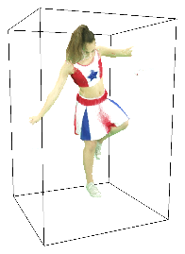
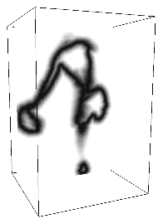
Our approach
Motion flow estimation based on inter-frame voxel matching [BLNL14]
Model-free Reconstruction
Template Mesh
Motion Flow
Mesh Animation
Global Deformation
Local Optimization
Volume Sequence
Volumes
EDT

Slide 11
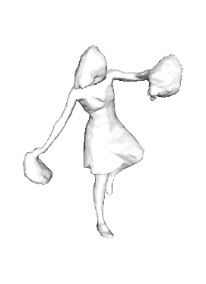
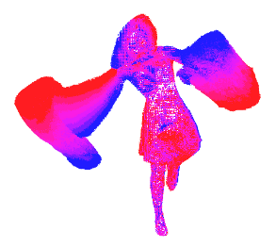
Our approach
Model-free Reconstruction
Template Mesh
Motion Flow
Mesh Animation
Global Deformation
Local Optimization
Volume Sequence
Volumes
EDT

Slide 12
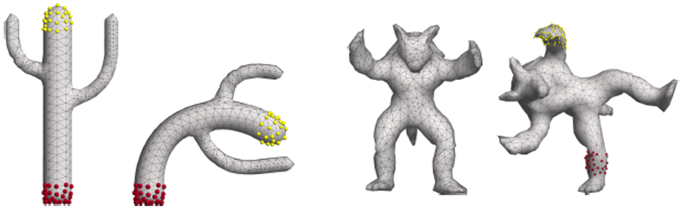
Pseudo-rigid mesh deformation
As-Rigid-As-Possible (ARAP) based global mesh deformation
Global energy minimization, driven by a set of anchor vertices
Locally rigid deformation
Preservation of the mesh structure
( source : Sorkine & Alexa, "As-Rigid-As-Possible Surface Modeling", 2007 )

Slide 13
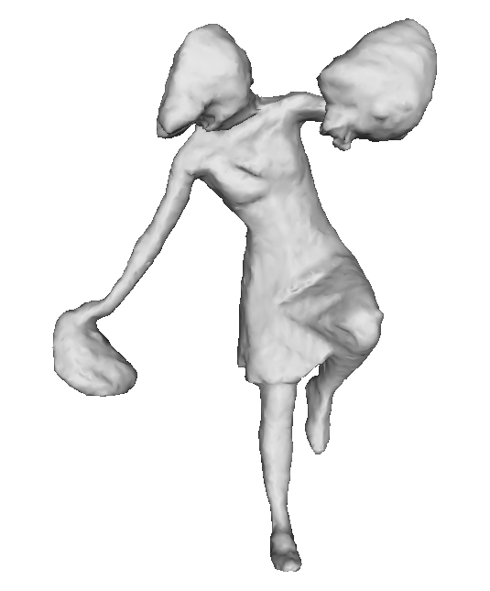
Pseudo-rigid mesh deformation
Anchors' selection
Automatic selection of the vertices associated with maximum EDT values
These points correspond to the largest character's motions

Slide 14
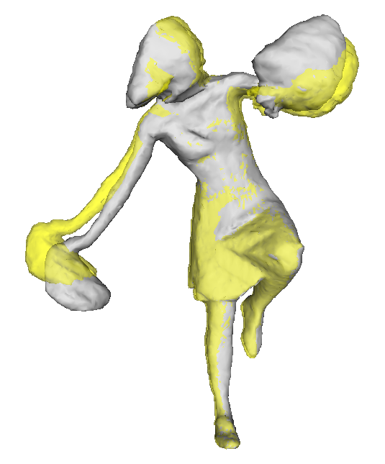
Pseudo-rigid mesh deformation
Anchors' selection
Automatic selection of the vertices associated with maximum EDT values
These points correspond to the largest character's motions

Slide 15
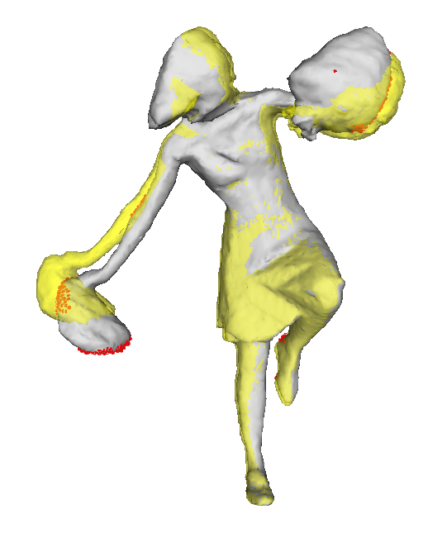
Pseudo-rigid mesh deformation
Anchors' selection
Automatic selection of the vertices associated with maximum EDT values
These points correspond to the largest character's motions

Slide 16
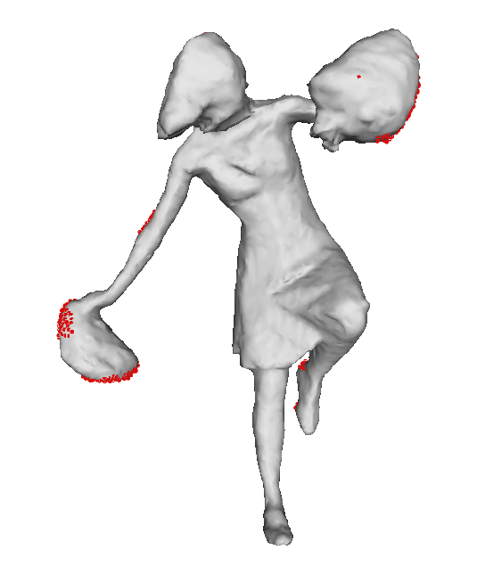
Pseudo-rigid mesh deformation
Anchors' selection
Automatic selection of the vertices associated with maximum EDT values
These points correspond to the largest character's motions

Slide 17
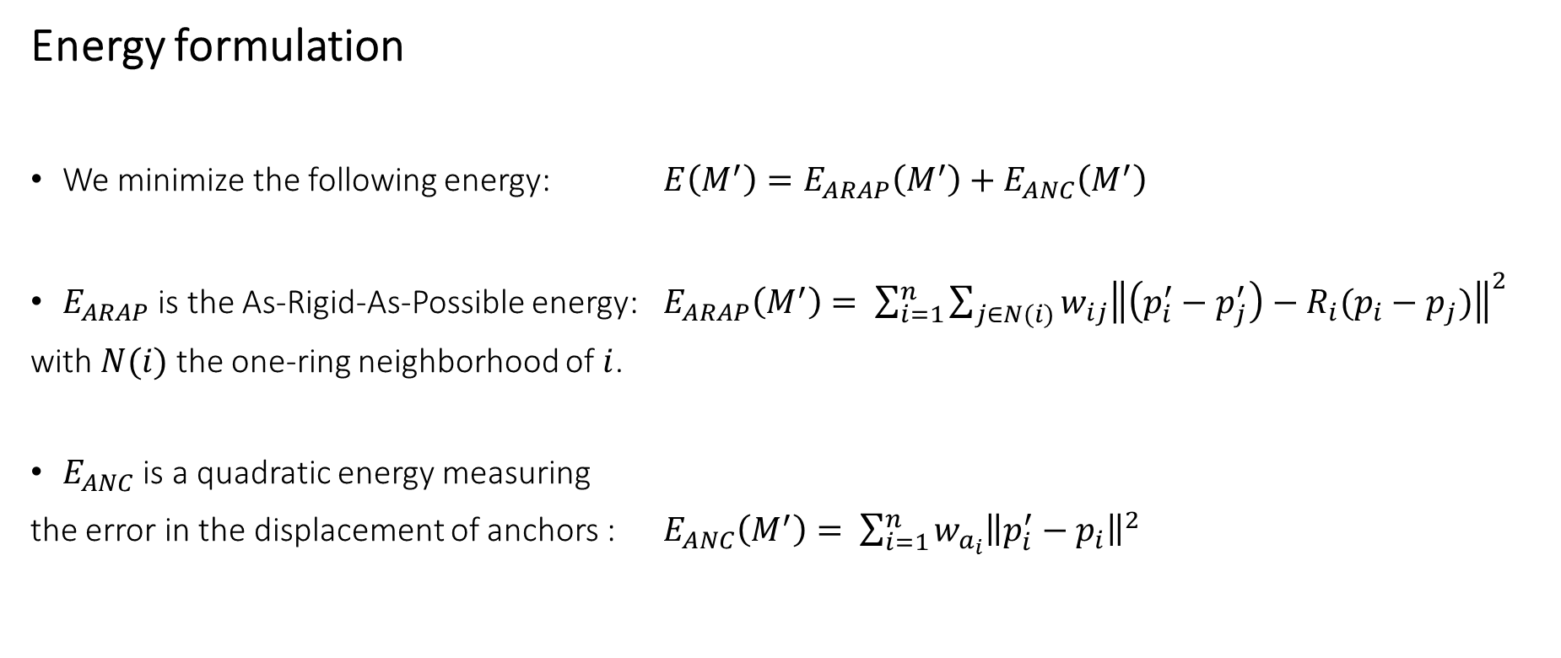
Pseudo-rigid mesh deformation
Energy formulation
We minimize the following energy: $E\left(M^{′}\right)=E_{ARAP}\left(M^{′}\right)+E_{ANC}\left(M^{′}\right)$
$E_{ARAP}$ is the As-Rigid-As-Possible energy: $E_{ARAP}\left(M^{′}\right)= \sum_{i=1}^{n}{\sum_{j∈N(i)}{w_{ij}{\left\|\left(p_{i}^{′}−p_{j}^{′}\right)−R_{i}(p_{i}−p_{j})\right\|}^{2}}}$
with $N(i)$ the one-ring neighborhood of $i$.
$E_{ANC}$ is a quadratic energy measuring
the error in the displacement of anchors : $E_{ANC}\left(M^{′}\right)= \sum_{i=1}^{n}{w_{a_{i}}{\left\|p_{i}^{′}−p_{i}\right\|}^{2}}$

Slide 18
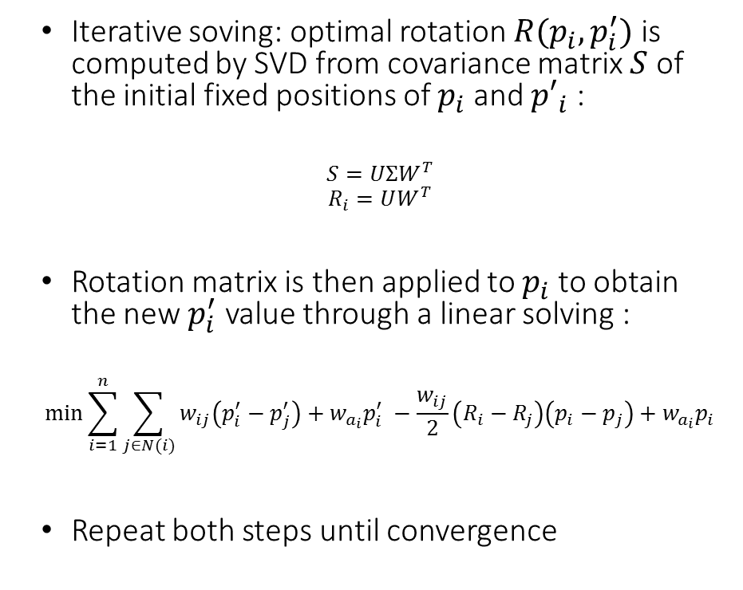
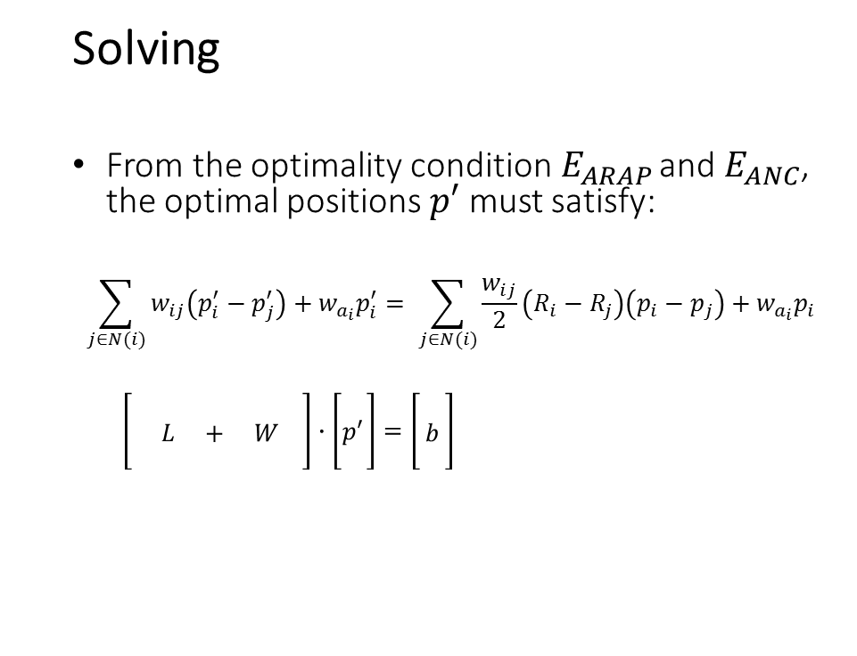
Pseudo-rigid mesh deformation
Solving
From the optimality condition$E_{ARAP}$ and $E_{ANC}$, the optimal positions $p′$ must satisfy:
$$\sum_{j∈N(i)}{w_{ij}\left(p_{i}^{′}−p_{j}^{′}\right)+w_{a_{i}}p_{i}^{′}= \sum_{j∈N(i)}{\frac{w_{ij}}{2}\left(R_{i}−R_{j}\right)\left(p_{i}−p_{j}\right)+w_{a_{i}}p_{i}}}$$
$$\left[\begin{matrix} \\ L + W \\ \end{matrix} \right]∙\left[\begin{matrix} \\ p^{′} \\ \end{matrix}\right]=\left[\begin{matrix} \\ b \\ \end{matrix}\right]$$
Iterative soving: optimal rotation $R(p_{i}, p_{i}^{′})$ is computed by SVD from covariance matrix $S$ of the initial fixed positions of $p_{i}$ and ${p′}_{i}$ :
$$S=UΣW^{T}$$
$$R_{i}=UW^{T}$$
Rotation matrix is then applied to $p_{i}$ to obtain the new $p_{i}^{′}$ value through a linear solving :
$$\min{\sum_{i=1}^{n}{\sum_{j∈N(i)}{w_{ij}\left(p_{i}^{′}−p_{j}^{′}\right)+w_{a_{i}}p_{i}^{′} −\frac{w_{ij}}{2}\left(R_{i}−R_{j}\right)\left(p_{i}−p_{j}\right)+w_{a_{i}}p_{i}}}}$$
Repeat both steps until convergence

Slide 19
Pseudo-rigid mesh deformation

Slide 20
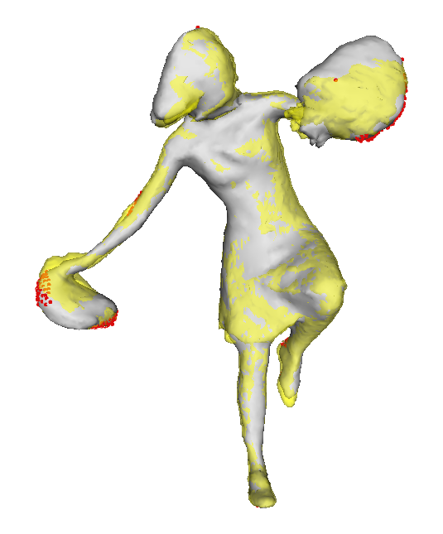
Pseudo-rigid mesh deformation

Slide 21
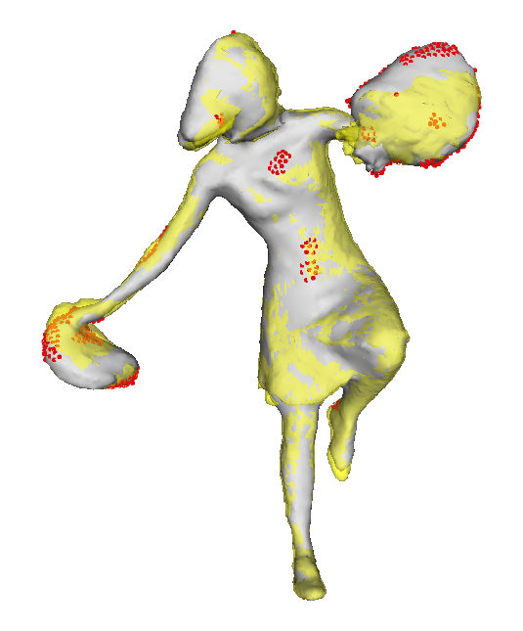
Pseudo-rigid mesh deformation
Adjustment
Complex motion tracking
New anchors' selection based on the EDT grid
Repeated until convergence

Slide 22
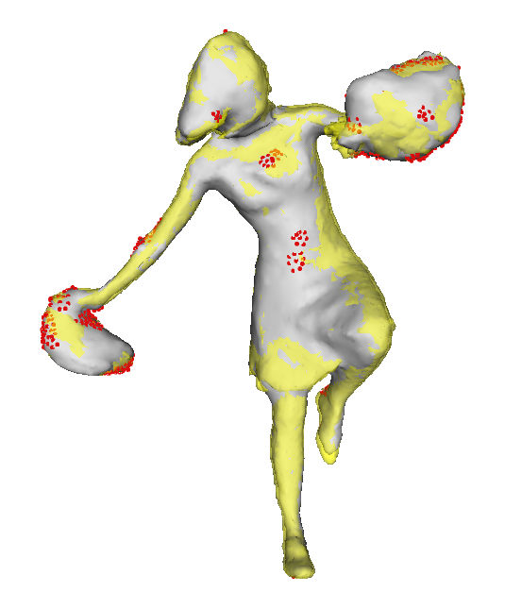
Pseudo-rigid mesh deformation
Adjustment
Complex motion tracking
New anchors' selection based on the EDT grid
Repeated until convergence

Slide 23
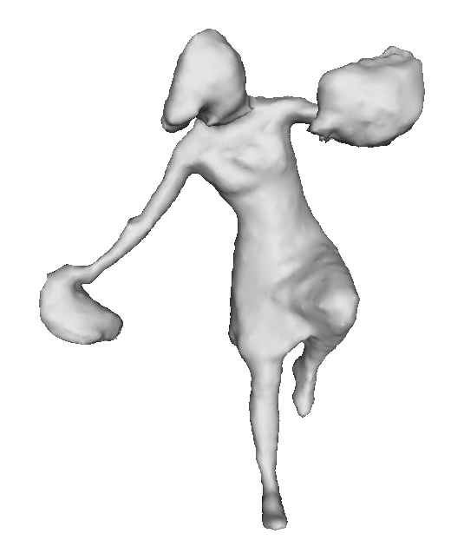
Pseudo-rigid mesh deformation
Adjustment
Complex motion tracking
New anchors' selection based on the EDT grid
Repeated until convergence

Slide 24
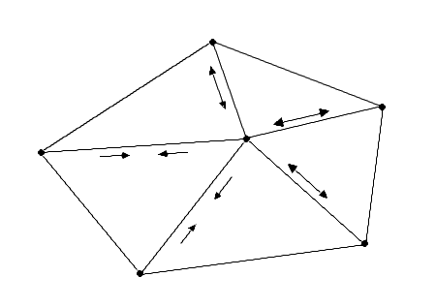
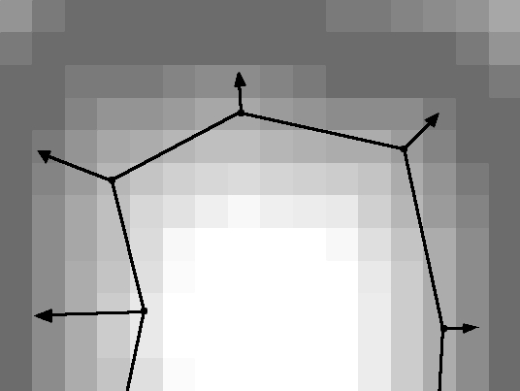
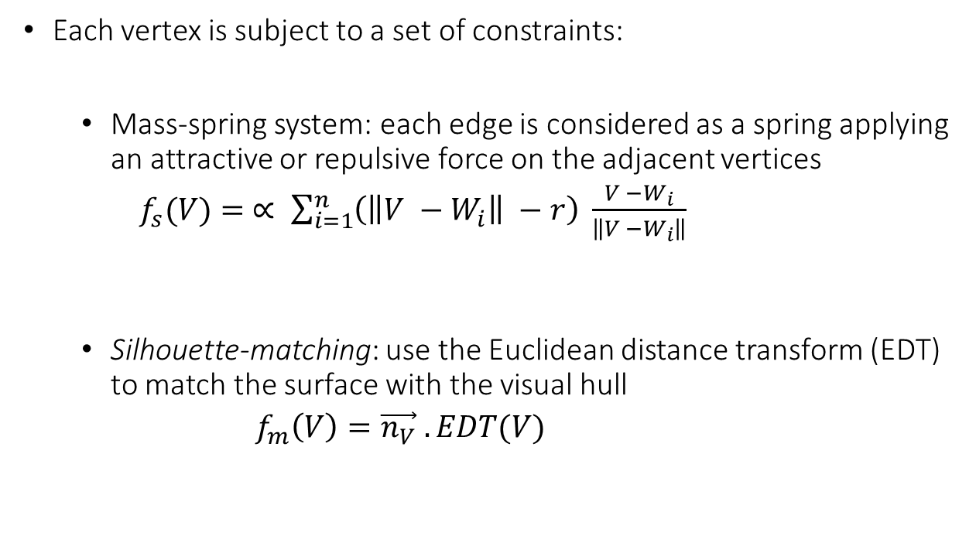
Local optimization
Each vertex is subject to a set of constraints:
Mass-spring system: each edge is considered as a spring applying an attractive or repulsive force on the adjacent vertices
$f_{s}(V)= ∝ \sum_{i=1}^{n}{\left(\left\|V −W_{i}\right\| −r\right) \frac{V −W_{i}}{\left\|V −W_{i}\right\|}}$
Silhouette-matching: use the Euclidean distance transform (EDT) to match the surface with the visual hull
$f_{m}\left(V\right)=\vec{n_{V}} . EDT(V)$

Slide 25
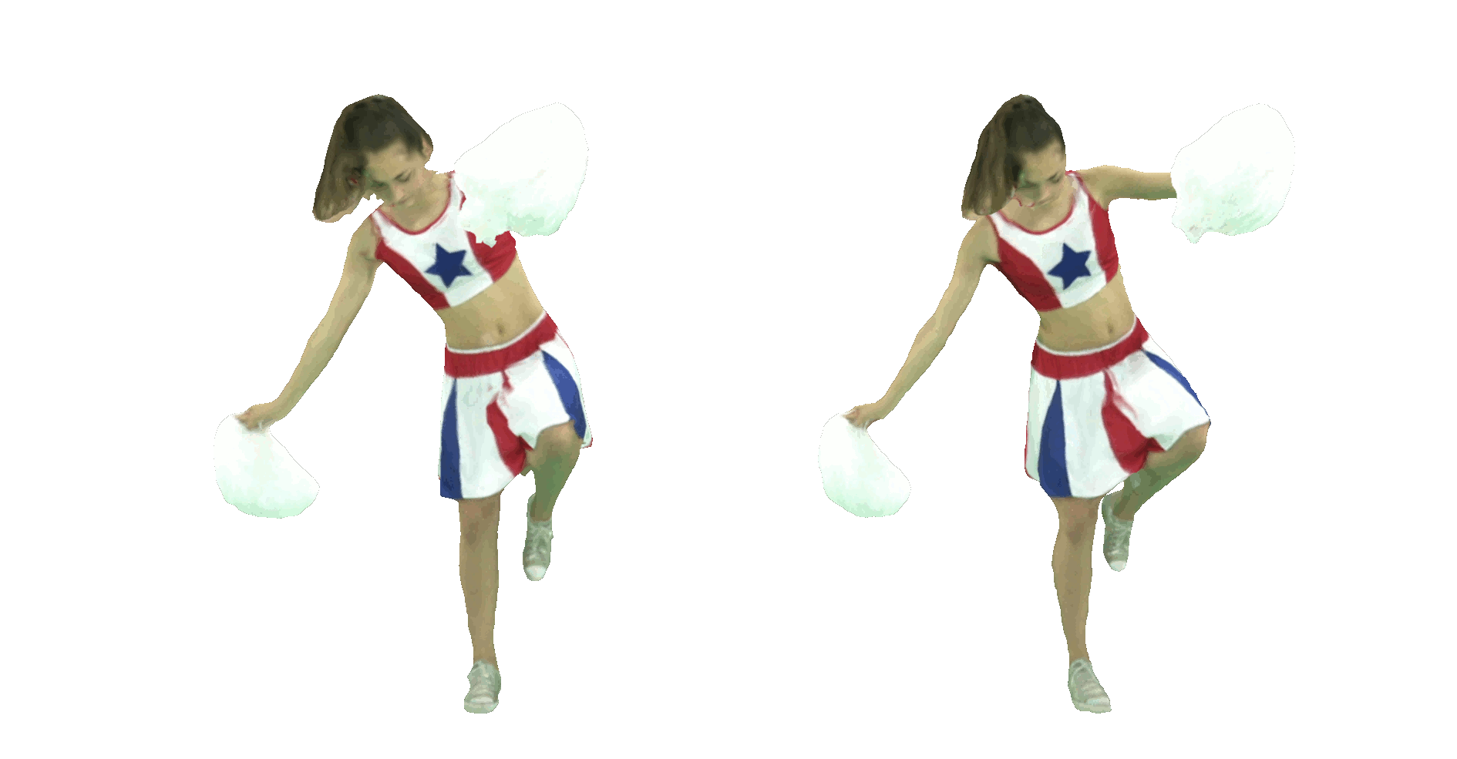
Results
One textured mesh per frame
A single textured, animated mesh

Slide 26
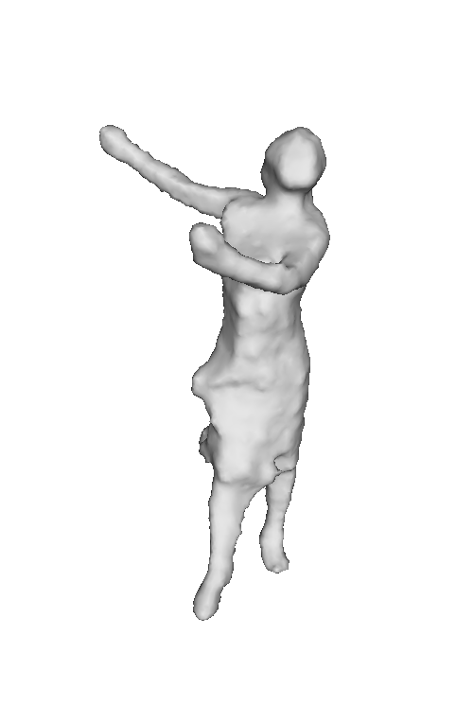
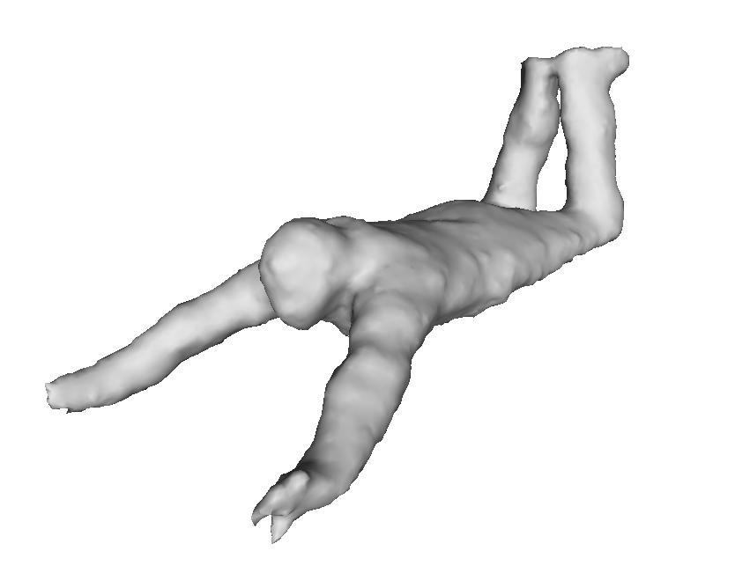
Results
 | [DeAguiar08] | Our
Total computing time | ~600 sec/frame | ~180 sec/frame
Average Hausdorff distance (w.r.t. bBox diag) between animated mesh and visual hull | ~0.011933 | ~0.003291

Slide 27
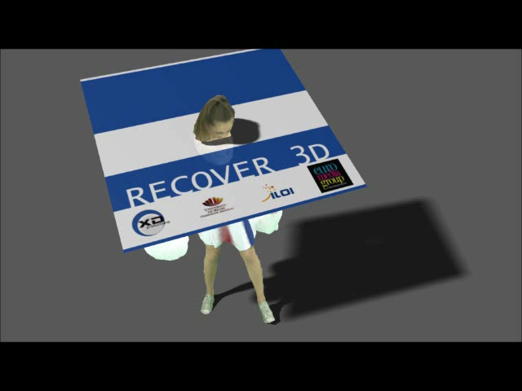
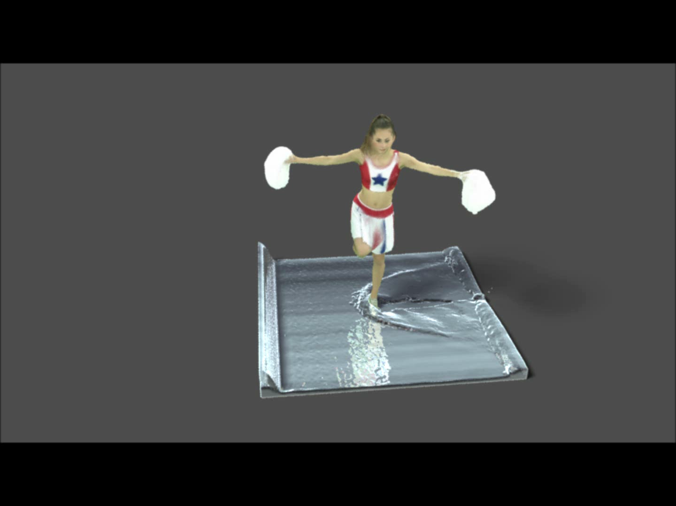
Results
Examples of dynamic interactions with virtual environment

Slide 28
Conclusion
Temporally coherent mesh animation from a model-free multi-view reconstruction.
Animated character fitted to interactions with a virtual environment.
Limitations
Sensitive to topology modifications
Artifacts appearing on critical mesh parts
Future work
Ensure robustness to long sequences
Adaptation to higher resolution datasets.

Slide 29
Thank you for your attention
Reconstructed mesh sequence
Temporally consistent mesh animation

